Slide 1
Location Verification Performance in the
Presence of Verifier Location Error
Ihsanullah
Ziqing Wang
Robert Malaney
Andrew Dempster
Shihao Yan

Slide 2
The Problem Statement
Performance Evaluation of a Signal Strength Location Verification System (LVS) in the presence of GNSS positioning errors.
We will use wireless communication signals received from a “claimant car” by other cars - so as to verify the claimed GNSS that is reported by the claimant.
The novel part of this work is that we will add location error to the GNSS position of the verifiers.

Slide 3
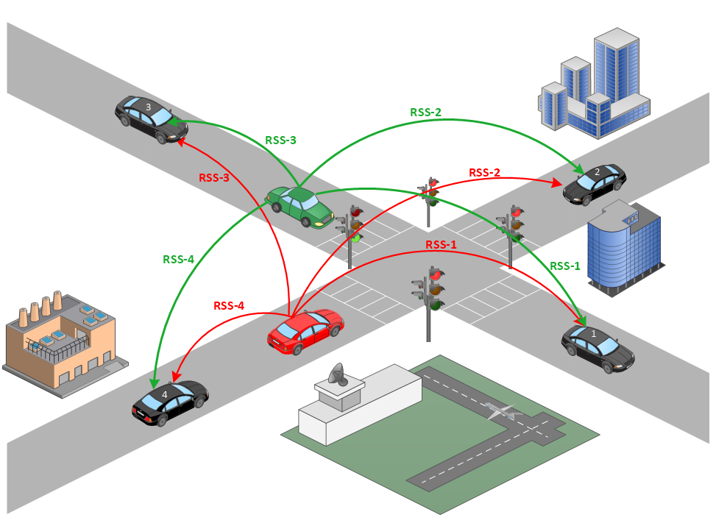
What is Already Done.
* (Yan, et al. 2016), S. Yan, I. Nevat, G. Peters and R. Malaney, "Location verification systems under spatially correlated shadowing", IEEE Transactions on Wireless Communications 15(6): 4132-4144.
Notes:
Spatially Correlated Shadowing model was considered.
Location Verification for a vehicle’s claimed location using optimal theoretic framework has been done earlier. If the malicious user’s location is not verified and it goes unnoticed then the following may occur,
Vehicle Collision.
Traffic Congestion.
Unoptimized Traffic Routing.

Slide 4
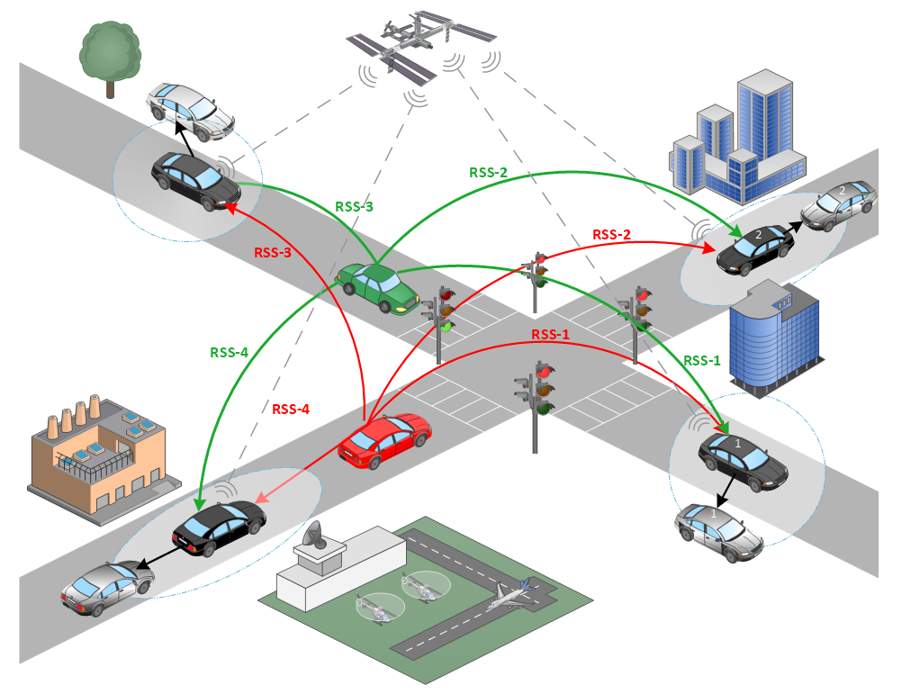
What’s New?
Notes:
The verifiers location cannot be 100% correct and they have got a certain degree of error on them (due to GNSS) which will impact the overall LVS performance. This limitation was not considered earlier and we studied the performance of the DRSS based LVS considering the location errors.

Slide 5
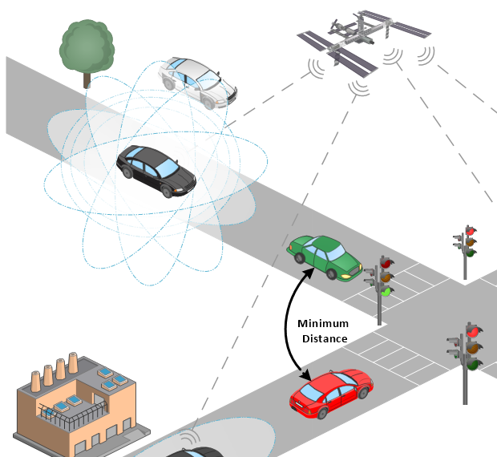
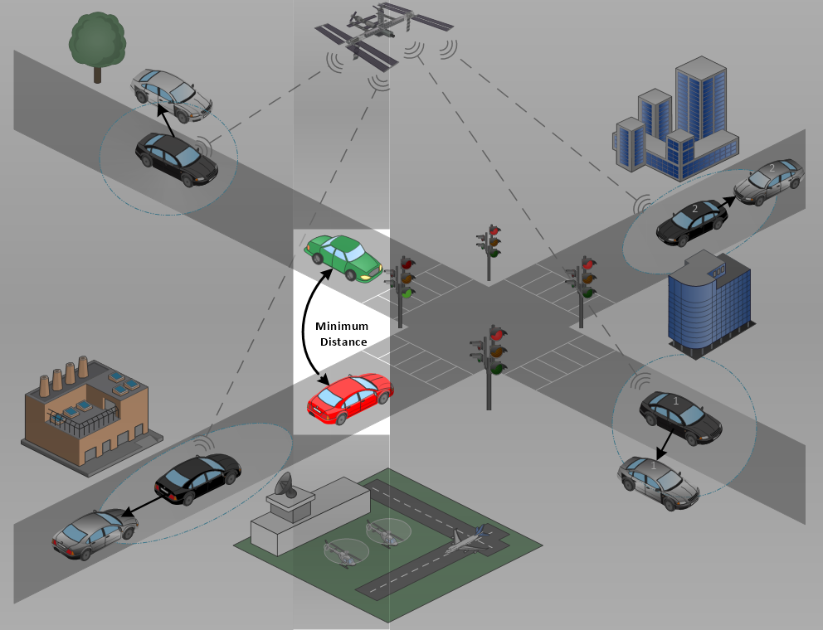
Main Idea
Studying the performance of optimal DRSS based LVS with,
Changing positioning errors in verifiers true location.
Changing number of verifiers.
Modification of the minimum distance constraint between true and claimed (untrue) position of malicious vehicle.
Uniform and non-uniform localization errors in x and y directions.

Slide 6
System Model
Channel conditions are a priori.
‘N’ number of verifiers with known location.
Introducing a gaussian localization error to the positions of verifiers.
A good user at the claimed location and a malicious user at the optimal attack location.
A minimum distance constraint for the malicious user.
LRT is used in the detection system.
System performance is evaluated by ‘False Positive Rate’ and ‘Detection Rate’.
Notes:
Pathloss Constant =3
Transmit Power for the use to be verified = 30 dBm
Reference Distance = 1
In this setup we consider Spatially Correlated Shadowing model with Constant Shadowing Variance = 5 and Dc = 400 (correlation distance).

Slide 7

Optimal Attack Location Calculation
Calculation of optimal location for the malicious vehicle,
$$X_{t}^{∗}= {}_{\left\|X_{t}−X_{c}\right\|≥r}^{argmin }{ φ(X_{t})}$$
Whereas,
$$φ\left(X_{t}\right)=\frac{1}{2}{\left(Δv −Δu\right)}^{T} D^{−1} \left(Δv −Δu\right)$$
Notes:
In the DRSS-based LVS, the malicious user only has to optimize his true location through minimizing the KL-divergence from f (H1) to f (H0), which is given by ϕ(xt).
Δ𝐮 and Δ𝐯 are the mean RSS vectors calculated using claimed location and optimal attack location respectively.
D is the covariance matrix of the DRSS vector and is calculated based on the location of the verifiers.

Slide 8
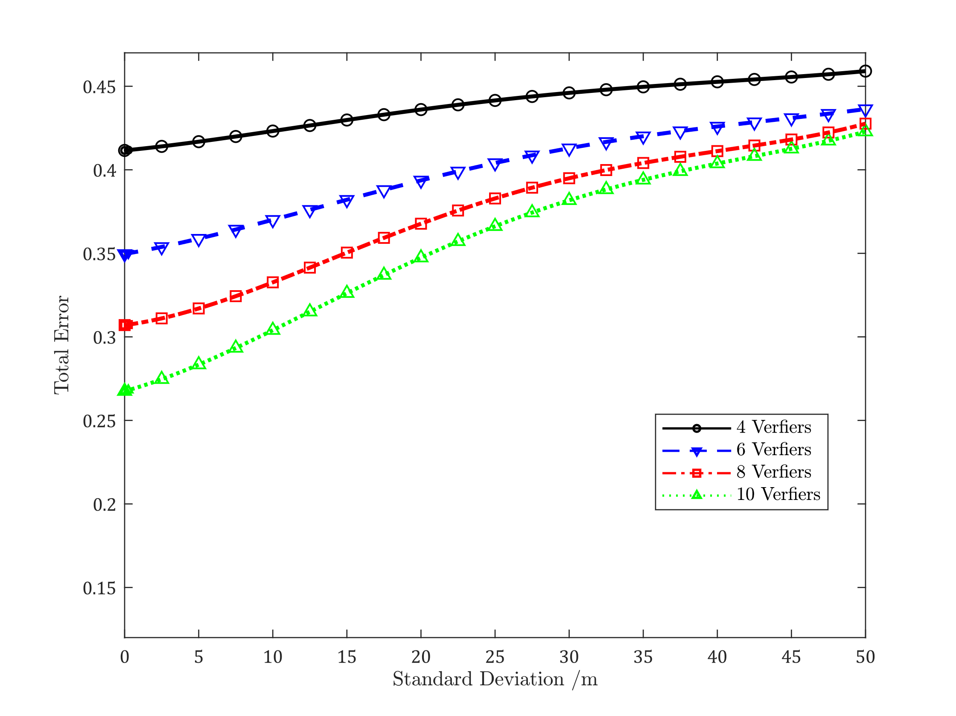
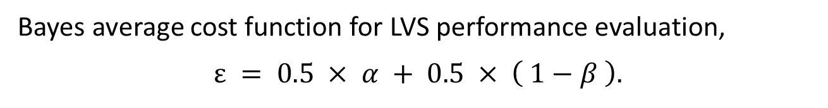
Results
Bayes average cost function for LVS performance evaluation,
$$ε = 0.5 × α + 0.5 × \left( 1−β \right).$$
Total Error
False Positive Rate
Detection Rate
Total error curves of the DRSS-based LVS for $σ_{dB}=5, D_{c}=400m, r=50m, X_{t}=X_{t}^{∗} and N=4, 6, 8, 10$
Notes:
Bayes average cost function is used to quantify the performance of the LVS in terms of total error, Whereas 𝛼 is the ‘False Positive Rate’ and 𝛽 is the ‘Detection Rate’.

Slide 9
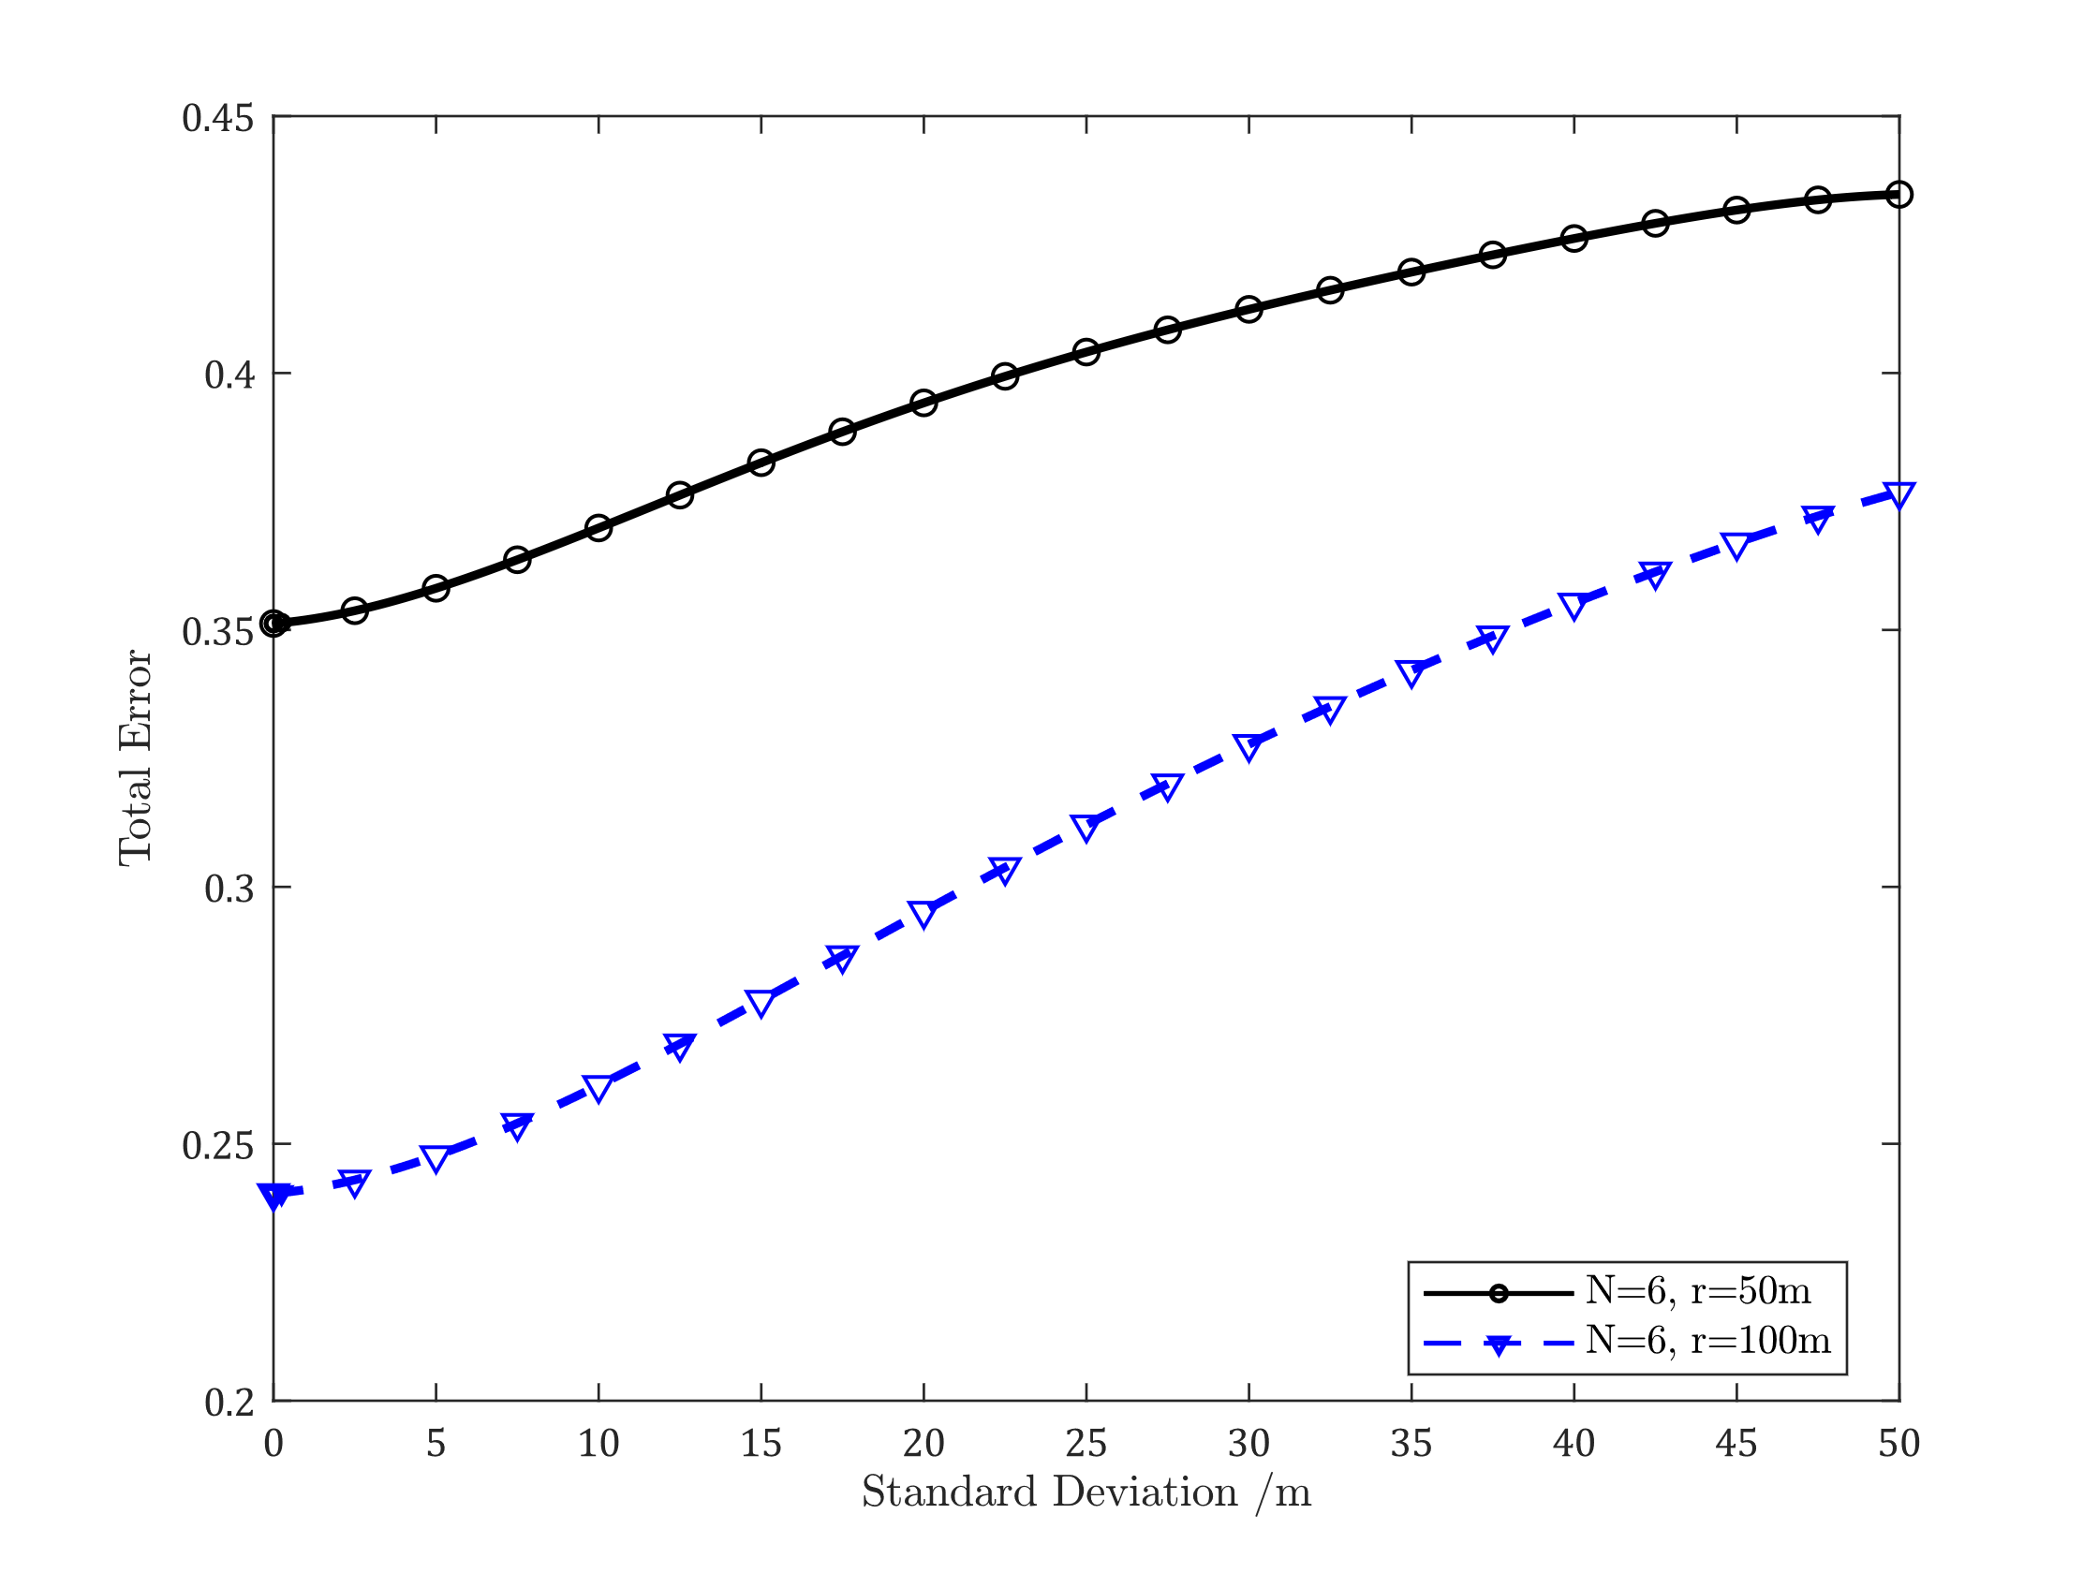
Results (Changing Distance Constraint)
Total error curves for $σ_{dB}=5, D_{c}=400m, r=50m \& 100m, X_{t}=X_{t}^{∗} and N= 6$.
Notes:
LVS performs better when the distance constraint is larger.

Slide 10
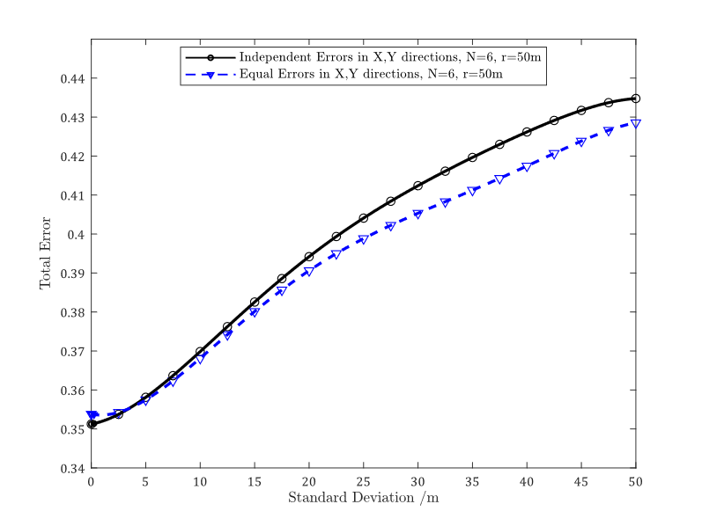
Results (Uniform/Non-Uniform Error in X & Y)
Total error curves (with independent/uniform location errors in X and Y) for $σ_{dB}=5, D_{c}=400m, r=50m, X_{t}=X_{t}^{∗} and N= 6$.

Slide 11
Summary
Location verification is critical.
LVS performance degrades by nearly 15% in the presence of location errors.

Slide 12
Q & A

Slide 13
Thank You!

